Slide 1

Neural Speech Waveform Generation
[2020]
Yi-Chiao Wu
Toda Lab, Nagoya University, Japan
Notes:
[opening]
Hello everyone, today, I would like to introduce my PhD research, Incorporating Prior Knowledge on Speech Production Mechanism into Neural Speech Waveform Generation for Voice Conversion.

Slide 2
Outline
Background: Speech generation
Speech modeling
WaveNet and Parallel WaveGAN
Topic 1: Pitch-aware generation model
Pitch-dependent dilated convolutional neural network (PDCNN)
Quasi-Periodic structure
Topic 2: Collapsed speech detection and suppression
Topic 3: Post-filter for TTS

Slide 3
Speech Modeling
Vocoder [H. Dudley, 1939]
Voice coder
Encode speech into acoustic features
Decode speech from acoustic features
Source filter model [R. McAulay+, 1986]
Excitation signal generation
Vocal fold movements
Spectral filtering
Vocal tract resonance
Lip radiation

Slide 4
Vocoder
Research focus
Notes:
Specifically, the vocoder techniques include two main categories, source-filter vocoder, and unified vocoder. A source-filter vocoder includes an excitation generation module and a resonance filtering module. The inputs are acoustic features and the output is speech waveform. For conventional vocoders, both modules are parametric-based. Because of the powerful modeling capability of neural networks, we can replace the excitation module with a neural network, or we can replace the filtering module with a neural network, too.
On the other hand, a unified vocoder directly models speech waveform with a single neural network. The inputs can be acoustic or linguistic features and the output is also speech waveform.
For my PhD research, I focus on improving the unified vocoders.

Slide 5
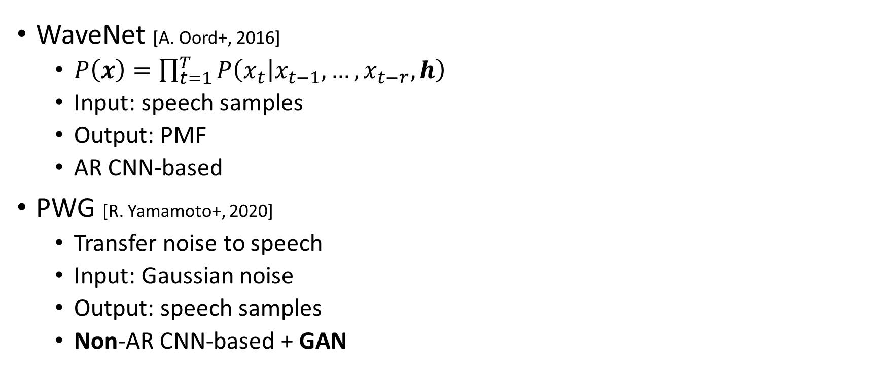
WaveNet and Parallel WaveGAN
WaveNet [A. Oord+, 2016]
$P\left(x\right)=\prod_{t=1}^{T}{P\left(\left.x_{t}\right|x_{t−1},…,x_{t−r},h\right)}$
Input: speech samples
Output: PMF
AR CNN-based
PWG [R. Yamamoto+, 2020]
Transfer noise to speech
Input: Gaussian noise
Output: speech samples
Non-AR CNN-based + GAN
Notes:
Before I start to introduce my proposed methods, I would like to briefly introduce the WaveNet and parallel WaveGAN vocoders.
WaveNet models the probability distribution of each speech sample conditioned on previous samples and acoustic features h.
PWG directly transfers Gaussian noise into speech samples conditioned on acoustic features.
Therefore, the inputs of WaveNet are previous speech samples, and the input of PWG is Gaussian noise.
The output of WaveNet is the Probability Mass Function of each sample, and the PWG directly output speech samples.
WaveNet is an autoregressive CNN-based model, and PWG is a non-autoregressive CNN-based model with a GAN structure.

Slide 6

Limited Pitch Controllability of WaveNet and PWG
Data-driven nature
Without many prior speech knowledge
Speech periodicity and continuity
It is hard for WaveNet and PWG to generate speech with accurate pitch when the input F₀ is outside the F₀ range of training data
Pitch-aware network is required
Pitch-dependent CNN (PDCNN)
Quasi-periodic (QP) structure
 | Normal | 2×F₀
Expected
PWG
QPPWG
Notes:
The current unified vocoders such as WaveNet usually achieve high fidelity speech generation. However, the data-driven nature and without many prior speech knowledge such as speech periodicity and continuity make these vocoder lack the tractability of speech components, and it will cause unexpected output problem.
In my research, I focus on the pitch controllability.
Specifically, for the parametric-based vocoder, if we change the fundamental frequency F0, the pitch of the vocoder-generated speech will also be changed corresponding to the input F0.
However, for the unified neural vocoder, if the new F0 is not in the observed F0 range of the training data, the pitch of the vocoder-generated speech is usually inconsistent with the input F0.
Here is an example. First, I play the speech with normal F0 .
Secondly, I play the speech with doubled F0.

Slide 7
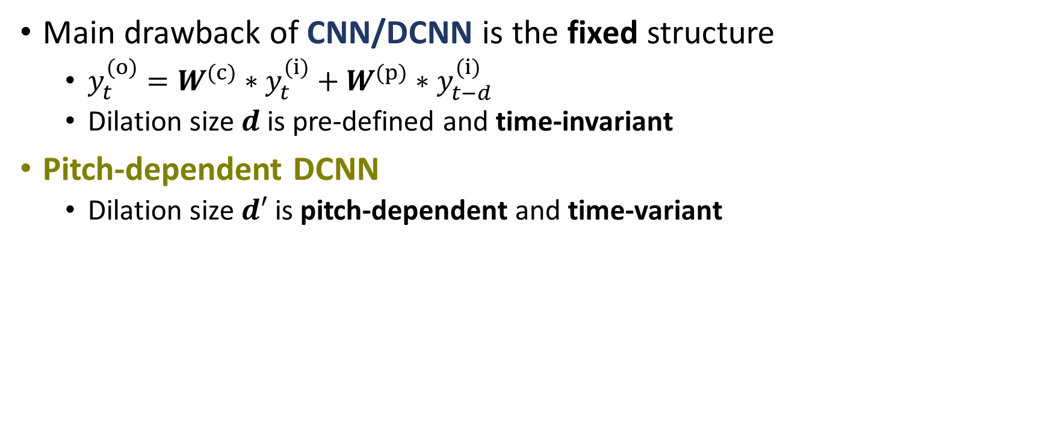
PDCNN [Y.-C. Wu+, 2019]
Main drawback of CNN/DCNN is the fixed structure
$y_{t}^{(o)}=W^{(c)}∗y_{t}^{(i)}+W^{(p)}∗y_{t−d}^{(i)}$
Dilation size $d$ is pre-defined and time-invariant
Pitch-dependent DCNN
Dilation size $d′$ is pitch-dependent and time-variant
Notes:
However, we know that the main drawback of CNN/DCNN is the fixed geometric structure.
Specifically, convolution with a size two kernel can be formulated like this formula. “y” is feature map, “I” denotes input, and “o” denotes output. “W^(c)” and “W^(p)” are trainable weight matrices for current and past samples, respectively. “t” is the time index, and “d” is the dilation size.
For CNN, “d” is set to one.
For DCNN, “d” is pre-defined and time-invariant.
However, for our proposed PDCNN, the dilation size “d’” is pitch-dependent and time-variant.
That is, the original dilation size “d” is multiplied by a time-variant pitch-dependent scale “E” to get the dilation size “d’” of PDCNN.

Slide 8
Quasi-Periodic Signal Modeling
Simultaneous model periodic and aperiodic components
Cascaded network of fixed and adaptive blocks
Fixed blocks w/ DCNNs
Model the aperiodic components with the nearest samples (short-term correlations)
Network architecture is fixed
Adaptive blocks w/ PDCNNs
Model the periodic part with prior F₀ knowledge (long-term correlations)
Network architecture is dynamically changed
Notes:
Since speech has periodic and aperiodic components , we propose a QP structure to simultaneously model them.
The QP structure is composed of cascaded fixed and adaptive blocks.
The fixed blocks with fixed network structures adopt DCNNs to model the short-term correlations of aperiodic components.
The adaptive blocks adopt PDCNNs to model the long-term correlations of periodic components, and its network architecture is dynamically changed according to the instantaneous F0.

Slide 9
QPNet [Y.-C. Wu+, 2019]
Apply the QP structure to WaveNet
Difference w/ WaveNet
Cascaded modules
Adaptive block w/ PDCNN
1/2 model size
Drawback
Generation is still slow
Notes:
First, we apply the QP structure to the WaveNet vocoder.
The block diagram of QPNet is shown in this figure.
The main difference from WaveNet is that QPNet replaces several fixed blocks of WaveNet with the proposed adaptive blocks to improve its pitch controllability and modeling efficiency.
With the proposed QP structure, QPNet achieves similar speech quality and higher pitch accuracy than WaveNet while the model size is halved of that of WaveNet. However, although the model size is reduced by 50%, it is still large.
The large network and AR-mechanism make the generation is still far away from real-time.

Slide 10
QPPWG [Y.-C. Wu+, 2020]
Apply the QP structure to the generator of PWG
Inherit from PWG
Multi-resolution STFT
Discriminator
Differences w/ QPNet
Non-AR
Gaussian noise input
Raw waveform output
1/20 model size
Notes:
As a result, we apply the QP structure to parallel WaveGAN (PWG), which is a compact and non-AR generative model. Since the discriminator and multi-STFT loss show the effectiveness in PWG training, the proposed QPPWG inherits them, and the main improvement is applying the QP structure.
Even if the model size of PWG is only 3% of WaveNet, QPPWG still further reduce 30% model size of PWG while achieving similar speech quality but higher pitch controllability.
On the other hand, compared with QPNet, the main difference of QPPWG is the Non-AR mechanism, Gaussian noise input, raw waveform output, and only 5 % model size.

Slide 11
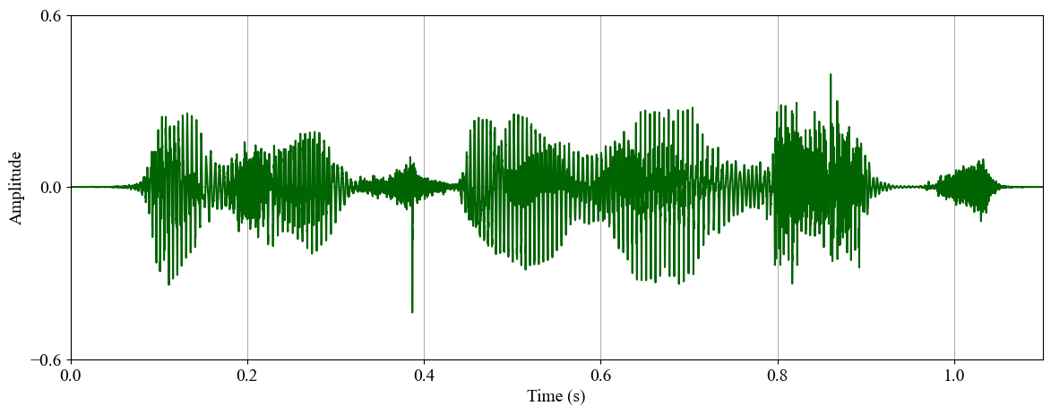
Collapsed Speech
WaveNet and PWG directly model speech waveform
Vulnerable to prediction errors
Few prediction errors cause markedly discontinuity
Significant perceptual degradation
Collapsed speech
Notes:
The inputs of the neural vocoders are voice converted acoustic features. However, theses acoustic features usually suffer from converted distortion, and it will easily cause prediction errors of the neural vocoders.
Since the neural vocoders directly model speech waveforms, few prediction errors will cause markedly discontinuity.
As show in this figure, the unexpected impulse noise causes significant perceptual quality degradation, and we call it a collapsed speech problem.
In my PhD research, I proposed a waveform domain constraint using the prior knowledge of speech continuity to tackle this collapsed speech problem.

Slide 12
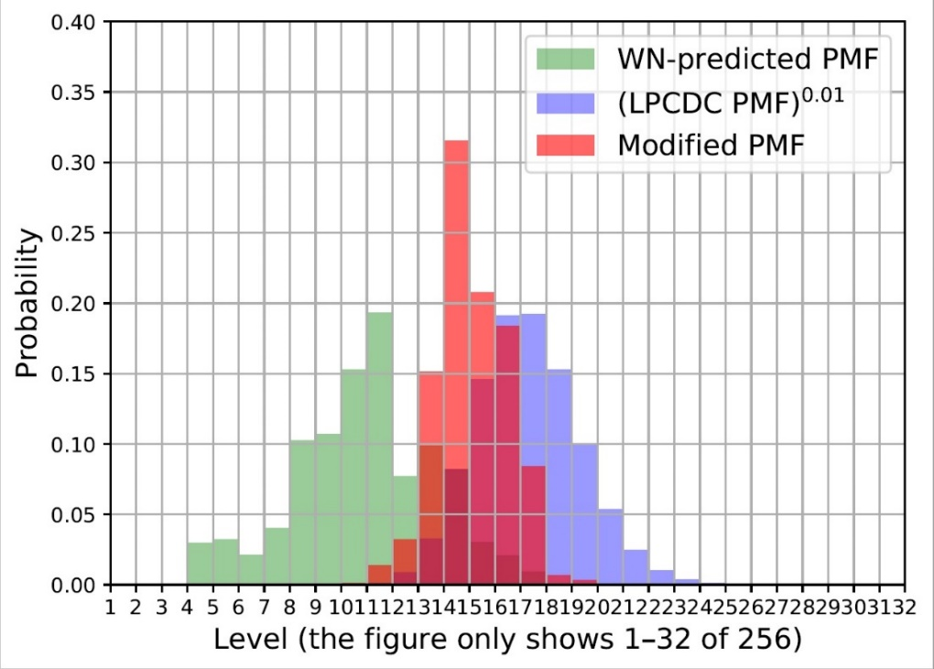
Waveform Constraint: LPCDC [Y.-C. Wu+, 2018]
Conventional vocoder outputs are usually stable
Extract LPC of conventional-vocoder-generated speech as reference
LPC distribution constraint (LPCDC)
Gaussian distribution
Mean: LPC predict value
Variance: variance of prediction errors
WaveNet output PMF
LPCDC PMF

Slide 13
Segmentally Detection: CSSD [Y.-C. Wu+, 2018]
Error propagation from conventional vocoder to WaveNet
Oversmoothing from LPCDC
Collapsed speech segment detection
Collapsed speech occurs in a short segment
Segmentally detect collapsed speech
Only apply LPCDC to the detected segments

Slide 14
Post Filter for Arbitrary TTS System
Building an advanced TTS system from scratch → expansive
A post-filter for existing or low-cost TTS systems→ economical
Taking a NN-based vocoder as the neural-post-filter (NPF)
Input: acoustic features
Output: speech waveforms
Acoustic mismatch and temporal mismatch problems
Notes:
As we know, to develop an advanced TTS system from scratch is expansive.
There are lots of time and resource consuming requirements such as labeled data with alignment information and an very deep neural network.
Therefore, we propose a post-filtering framework for existing or low-cost TTS systems. Since the proposed framework is generalized for arbitrary TTS system, and the label and alignment information are not required, the proposed method is economical.

Slide 15
Acoustic Mismatch
Training stage
Input: features of natural speech
Output: natural speech waveforms
Testing stage
Input: features of synthetic speech
Acoustic mismatch between training and testing inputs causes degradation
Problems of NPF - I
Notes:
However, there are two main challenges of building a neural-post-filter.
First, if we directly take a neural-vocoder as the post-filter, the vocoder will suffers from acoustic mismatch.
Specifically, the inputs of a vocoder are acoustic features, and the output is speech waveform.
In the training stage, the vocoder is usually trained with paired natural acoustic features and speech waveform.
However, in the testing stage, the inputs are the synthetic features extracted from TTS speech. The mismatch between training and testing usually causes significant quality degradation.

Slide 16
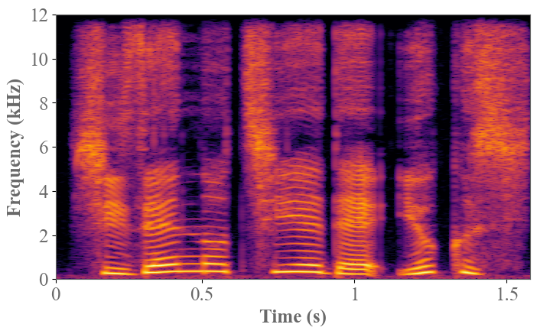
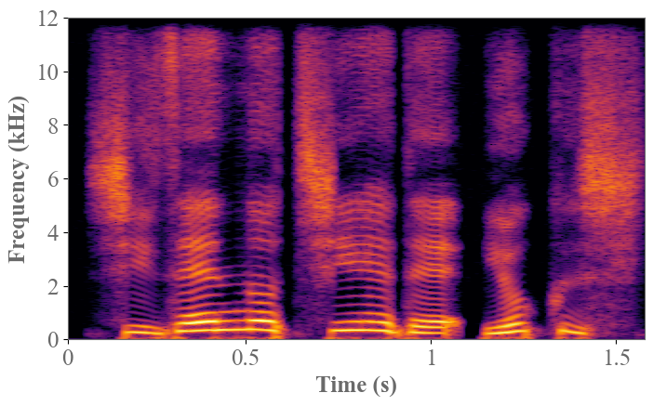
Temporal Mismatch
Training the NPF w/ synthetic features
Input: features of synthetic speech
Output: natural speech
Temporal mismatch between synthetic and natural speech causes degradation
Problems of NPF - II
Natural
TTS w/ natural segmentations
Different temporal spectral structures
Notes:
Even if we directly train the neural vocoder using the synthetic features and natural waveform, the temporal mismatch between them still causes significant quality degradation.
Here is an example, we can find that the temporal structures of natural and synthetic spectra are slightly different, and it will causes serious mismatch especially for autoregressive models.

Slide 17
Cycle-VC for Neural-Post-Filter
Source: synthetic; Target: natural
Enhanced path: convert synthetic features to natural features
Pseudo VC path: cyclically convert natural features
Notes:
In the proposed cycle-VC framework for post-filtering, we take the synthetic features as the source and the natural features as the target.
Specifically, the framework includes an enhanced path to convert the synthetic features to natural features and a pseudo VC path to cyclically convert the natural features.

Slide 18
Pseudo VC for Neural-Post-Filter Training
Pseudo VC features are suitable for NPF training
Temporal structures of pseudo VC feature and natural speech are matched
Acoustic structures of pseudo VC and enhanced features are similar
Notes:
Since the cycle-VC model is frame-based, the temporal structures are still maintained after the spectral conversion.
That is, the temporal structures of the pseudo VC features and the natural speech are matched while the acoustic characteristic of the pseudo VC features are similar to the enhanced features.
As a result, training the neural vocoder using the pseudo VC features avoids the temporal mismatch problem.

Slide 19
Neural-Post-Filter for TTS
Using enhanced features eases the acoustic mismatch
Acoustic characteristics of pseudo VC and enhanced features are similar
Both of them suffers from the distortions caused by the VC model
Notes:
In the testing stage, the synthetic features are first enhanced by the StoT conversion model, and then the vocoder generates the enhanced speech.
Since the acoustic characteristics of the enhanced features are similar to the pseudo VC features, the acoustic mismatch between the training and testing inputs is reduced.

Slide 20
Selected Publication
LPCDC w/ CSSD
Y. -C. Wu et al. “The NU non-parallel voice conversion system for voice conversion challenge 2018”, in Proc. Odyssey, 2018.
Y. -C. Wu et al. “Collapsed speech generation and suppression for WaveNet vocoder ,” in Proc. Interspeech, 2018.
Y. -C. Wu et al. “Non-parallel voice conversion system with WaveNet vocoder and collapsed speech suppression,” IEEE Access, 2020.
QPNet
Y.-C. Wu et al. “Quasi-Periodic WaveNet vocoder: a pitch dependent dilated convolution model for parametric speech generation ,” in Proc. Interspeech, 2019.
Y.-C. Wu et al. “Statistical voice conversion with Quasi-Periodic WaveNet vocoder ,” in Proc. SSW10, 2019.
Y.-C. Wu et al. “Quasi-Periodic WaveNet vocoder: an autoregressive raw waveform generative model with pitch-dependent dilated convolution neural network,” IEEE TASLP, 2020. (under review)
QPPWG
Y.-C. Wu et al. “Quasi-Periodic parallel WaveGAN vocoder: a non-autoregressive pitch-dependent dilated convolution model for parametric speech generation,” in Proc. Interspeech, 2020.
Y.-C. Wu et al. “Quasi-Periodic parallel WaveGAN vocoder: a non-autoregressive raw waveform generative model with pitch-dependent dilated convolution neural network,” IEEE TASLP, 2020. (under review)
Neural-post-filter
Y.-C. Wu et al. “A cyclical post-filtering approach to mismatch refinement of neural vocoder for text-to-speech systems,” in Proc. Interspeech, 2020.

Slide 21
Thank you for your attention ! https://bigpon.github.io/QuasiPeriodicParallelWaveGAN_demo/ https://bigpon.github.io/QuasiPeriodicWaveNet_demo/ https://bigpon.github.io/LpcConstrainedWaveNet_demo/ https://bigpon.github.io/CycleNeuralPostFilter_demo/

Slide 22
Mean Opinion Score of Speech Quality
Score: 1(lowest)–5(highest)
QPNet/QPPWG outperform the same sized WN/PWG
QPNet/QPPWG comparable to the larger sized WN/PWG
QPPWG outperform the 1.5 sized PWG w/ scaled F₀
Notes:
For speech quality, we also conducted MOS tests for normal F0 and scaled F0 scenarios.
According to the results, we can find that QPNet and QPPWG respectively outperform the same sized WaveNet and PWG and achieve comparable speech quality to the larger sized WaveNet and PWG in all scenarios.
QPPWG even outperform the 1.5 sized PWG in scaled F0 scenarios.

Slide 23
ABX of Pitch Accuracy
X: WORLD-generated reference
QPNet attains perceptually higher pitch accuracy than WN
QPPWG attains perceptually higher pitch accuracy than PWG
Notes:
We also conducted ABX test to evaluate the perceptual pitch accuracy.
At each trial, we play a reference utterance and two test utterances and ask the listeners to choose which test utterance’s pitch is more consistent with the reference.
Since we don’t have the ground truth of natural speech with scaled F0, we take WORLD-generated speech as the reference.
According to the results, we can find that QPNet attains perceptually higher pitch accuracy than WaveNet, and QPPWG also attains perceptually higher pitch accuracy than PWG.

Slide 24
Real-Time Factor
CPU (2.60 GHz, 32 threads)
Number of blocks ↓ ➔ Generative speed ↑
GPU
Feature map indexing degrades the CNN parallelization
Complexity ↑ ➔ Generative speed ↓
 | PWG_20 | PWG_30 | QPPWG_20
Intel Xeon Gold 6142 | 0.474 | 0.579 | 0.512
Nvidia TITAN V | 0.011 | 0.016 | 0.020
Notes:
Since our goal is building a real-time system, we also evaluated generative speed in real-time factor.
First, we tested on a CPU with 2.6 GHz and 32 threads.
According to the result, we can find that because of the reduced model size, the generative speed of QPPWG is faster than that of original PWG. However, when tested on a GPU, because of the QP structure degrades the CNN parallelization.
The generative speed of QPPWG is slower than original PWG.
However, since the generation is much faster than real-time, the increased time is insignificant.

Slide 25
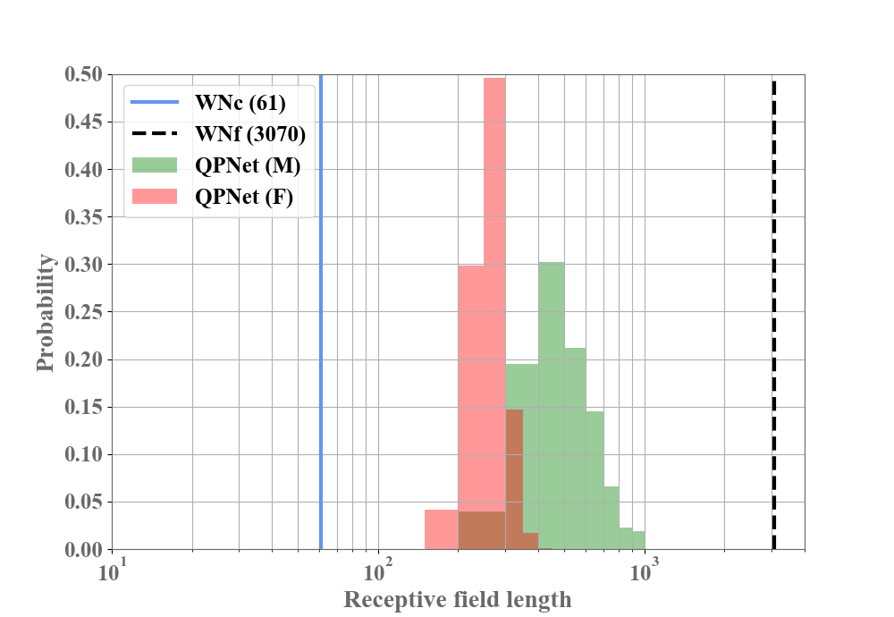
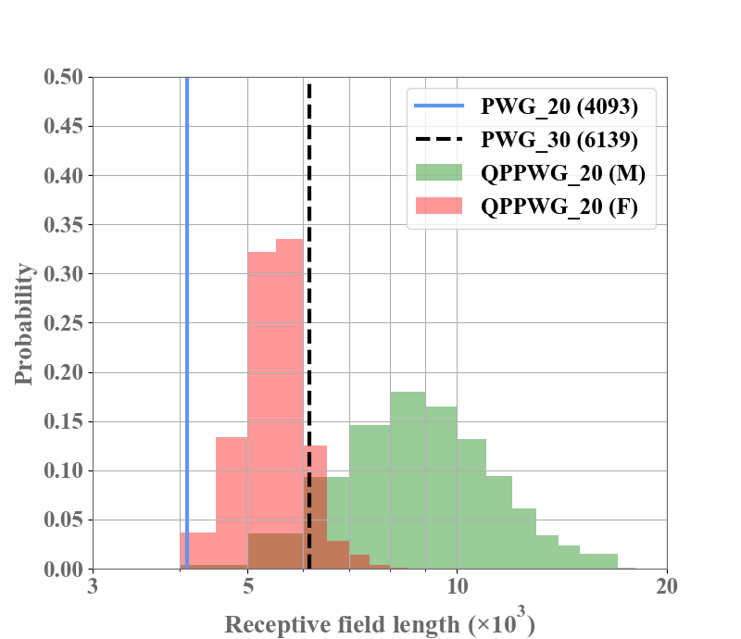
Receptive Field Extending
Efficiently increasing receptive field length
Skip some redundant information
Notes:
We also plot the receptive fields of QPNet and WaveNet, and QPPWG and PWG. We can find that the QP structure efficiently increases the receptive field length by skipping some redundant information.

Slide 26
PDCNN Implementation
2×1 CNN = 1×1 CNN^{(c)} + 1×1 CNN^{(p)}
Getting the dilation size of each sample
Indexing feature map according to the dilation size
Summation of convolution results
Indexing
Notes:
[PDCNN implementation]
For the implementation of PDCNN, since directly modifying the CNN module to dynamically change the dilation size is difficult and not hardware-friendly, we dynamically index the input feature map which is equivalent to changing the dilation size. Specifically, the results of a 2×1 CNN are equivalent to the summation of the results of two 1×1 CNNs namely CNN^{(c)} for the current samples and CNN^{(p)} for the past samples. Therefore, we first get the dilation size of each sample, and then we index the input feature map of the 1×1 CNN^{(p)} according to the dilation size. Finally, we summation the results of CNN^(c) and CNN^(p) to get the PDCNN results.

Slide 27
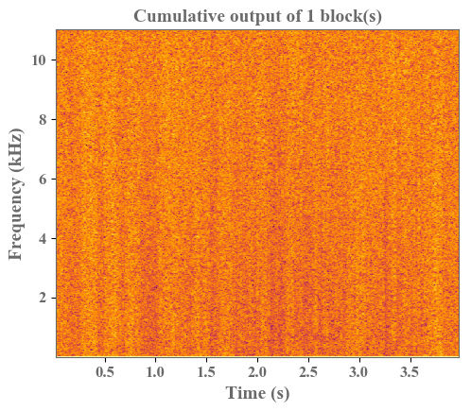
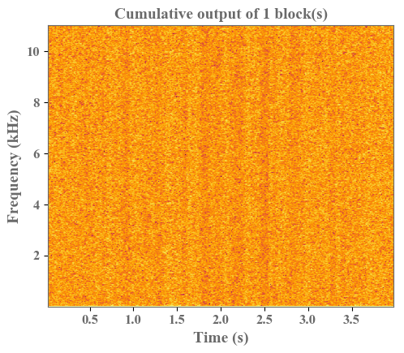
Understanding of QP Structure
Visualized intermediate outputs
Cumulative output of skip connections
PWG
QPPWG (adaptive → fixed)
Notes:
Since PWG and QPPWG directly output raw waveform samples, we can easily dissect the model to understand the internal generation mechanism.
According to the visualized cumulative intermediate outputs, we can find that PWG gradually generates both harmonic and non-harmonic components.
However, the QPPWG model with an adaptive-to-fixed order first generates the harmonic components and then the non-harmonic components.
That is, the first 10 adaptive blocks focus on modeling pitch-related components and the last 10 fixed blocks focus on modeling spectral-related components.

Slide 28
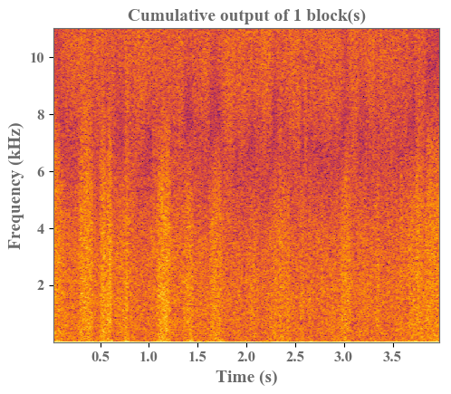
Understanding of QP Structure
Adaptive ➔ modeling source signal
Fixed ➔ spectral filtering
QPPWG (fixed → adaptive)
QPPWG (adaptive → fixed)
Notes:
In contrast to the QPPWG model with an adaptive-to-fixed order, the QPPWG model with a fixed-to-adaptive order first focuses on non-harmonic components and then generate harmonic components.
The visualized results confirm our assumption that the adaptive blocks modeling the pitch-related components with long-term dependencies, and the fixed blocks modeling the spectral-related components with short-term dependencies.

Slide 29
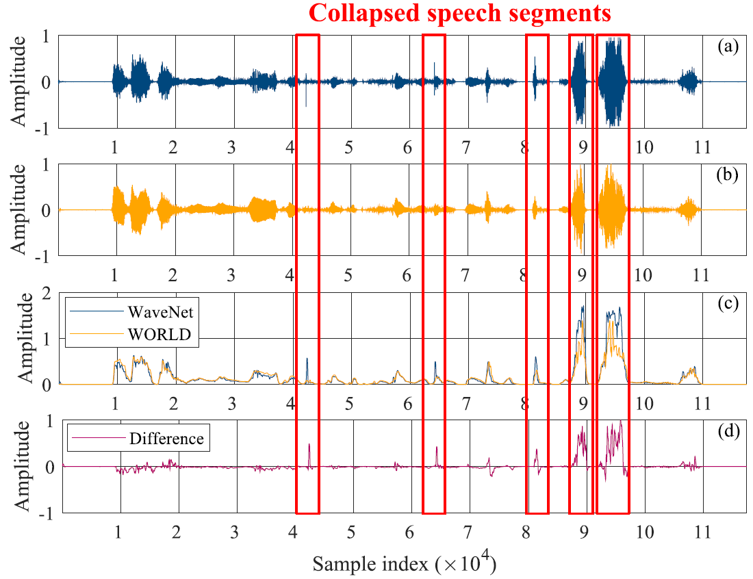
Collapsed Speech Segments Detection
Envelope detection [C. Jarne, 2017]
Notes:
1. concept
2. advantage
3. disadvantage

Slide 30
Mean Opinion Score of Speech Quality
Score: 1(lowest)–5(highest)
Collapsed speech causes marked quality degradation
LPCDC introduces negative effects
CSSD + LPCDC segmentally suppresses collapsed speech
Notes:
We conducted subjective mean opinion score evaluation to show the effectiveness of our proposed method.
First, we label the generated utterances to divide them into two subsets. One is collapsed-free set and another one is collapsed set.
According to the MOS results, we can find that the collapsed speech significantly degrades the speech quality.
If we only apply LPCDC, the speech quality even becomes worse because of the error propagation.
However, if we apply LPCDC with CSSD, the speech quality become much better.
The subjective results show the effectiveness of our proposed method to detect and suppress the collapsed speech.

Slide 31
Speaker Similarity Evaluation
Are the generated speech and natural speech from the same person?
Similarity score = same (%) + maybe the same (%)
CSSD +LPCDC maintains the same speaker similarity
Notes:
We also conducted subjective similarity evaluations.
At each trial, we play a target utterance and a generated utterance to a listener, and ask the listener whether the two utterances are from the same person or not.
There are four choices, the same, maybe the same, maybe different, and different.
The similarity score is the summation of the same and maybe the same.
According to the results, we can find that WaveNet achieves higher speaker similarity than the conventional vocoder WORLD, and applying the proposed CSSD and LPCDC to WaveNet maintains the same speaker similarity.

Slide 32
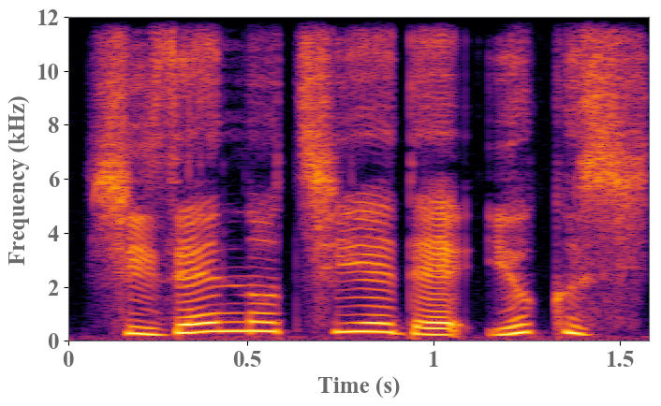
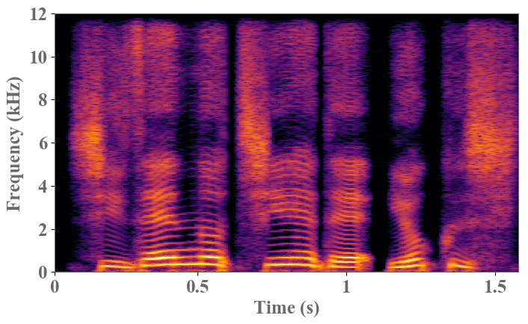
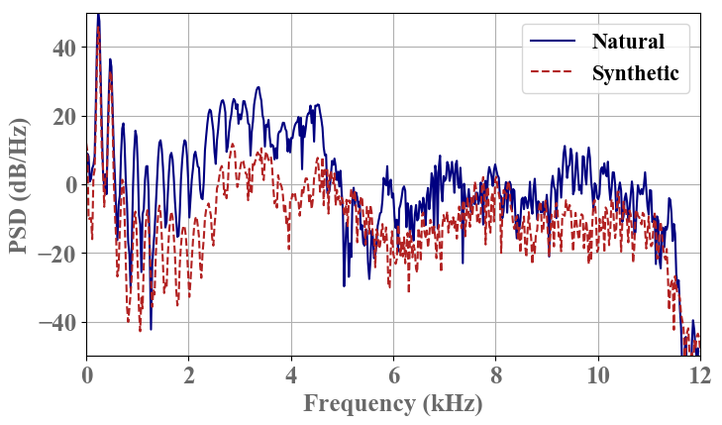
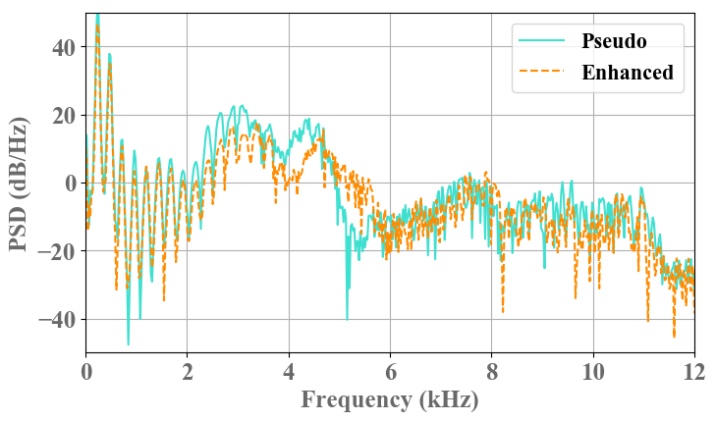
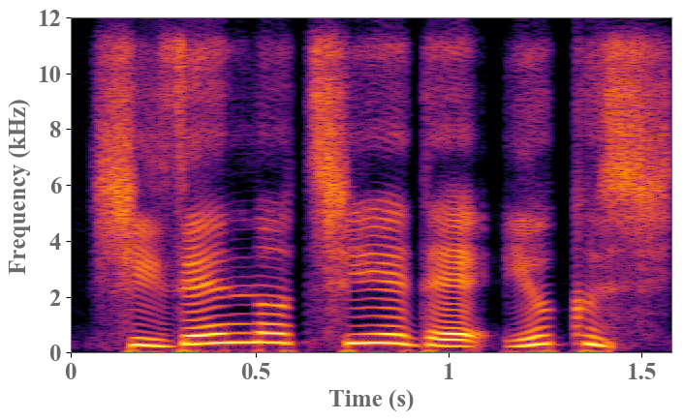
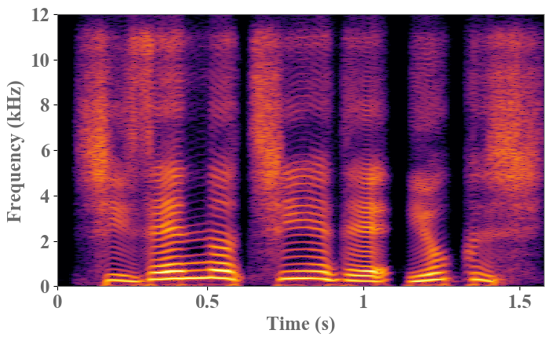
Effectiveness of Proposed Framework
Temporal mismatched
Temporal matched
Natural
Synthetic
PSD around 0.02 sec
Similar over-smoothing spectra
Pseudo VC
Enhanced
Notes:
Here is an example.
According to the natural and synthetic spectra, we can find the different temporal structures such as the format locations.
However, after the cyclical conversion, the pseudo VC spectrum still keeps the same temporal structures.
Moreover, the pseudo VC and enhanced spectra have similar acoustic characteristics such as both of them suffer the over-smoothing effect.
If we plot the power spectral density of a short segment, we can find that the natural and synthetic spectra are very different.
However, after the conversion, the pseudo VC and enhance spectra are much similar.

Slide 33
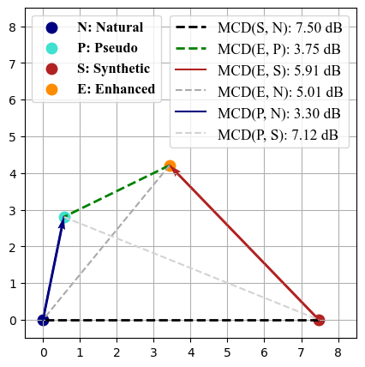
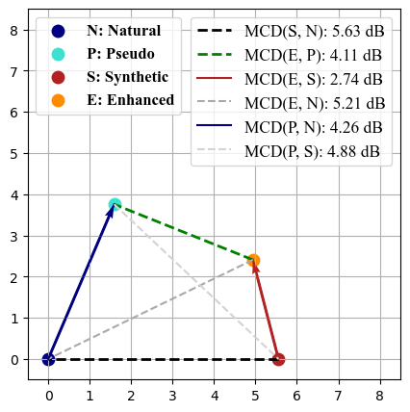
Effectiveness of Cycle-VC
Measure spectral similarity using mel-cepstral distortion (MCD)
The distances on the MCD-plane are MCDs
DNN-based TTS
HMM-based TTS
After cycle-VC, MCD of pseudo VC and enhanced features is low implying the spectral similarity.
MCD of synthetic to natural features is the highest implying the larger difference.
Notes:
To show the effectiveness of the Cycle-VC module, we plot the relationships among natural, pseudo VC, synthetic and enhanced features on a MCD-plane. Each distance between two points on the plane represents their MCD.
According to the figures, we can find that the MCD of natural and synthetic features is the highest, and the high MCD implies the large spectral difference.
However, after conversion, the MCD of pseudo VC and enhanced features becomes much lower, and the lower MCD means the more similar spectra.

Slide 34
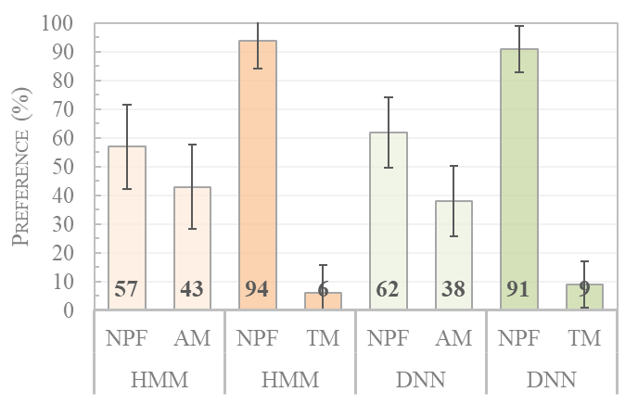
Subjective Evaluation of Mismatch Refinement
Preference test of speech quality
AM: acoustic mismatch
TM: temporal mismatch
Cycle-VC greatly eases mismatch problems
 | Acoustic features
 | Training | Testing
Natural | Natural | Natural
DNN-AM |  | Synthetic
HMM-AM |  | Synthetic
DNN-TM | Synthetic | Synthetic
HMM-TM | Synthetic | Synthetic
DNN-NPF | Pseudo VC | Enhanced
HMM-NPF | Pseudo VC | Enhanced
Notes:
Furthermore, we also conducted a preference test to evaluate the speech quality of the proposed neural-post-filter compared with the post-filters suffering form the acoustic mismatch and temporal mismatch.
According to the results, we can find that the proposed method greatly eases the mismatch problems.
Here are some demos.
First, I play the sound of the proposed method based on the DNN-TTS.
Secondly, I play the result suffering the acoustic mismatch.
Then, I play the proposed method again.
Last, I play the result suffering the temporal mismatch.
We can find that the proposed method achieves higher speech quality.

Slide 35
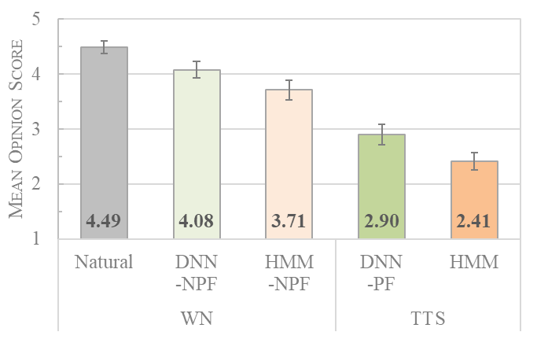
Subjective Evaluation of Neural-Post-Filter
Mean opinion score (MOS) of speech quality
1 (lowest)–5 (highest)
Proposed NPF greatly improve speech quality of arbitrary existing low-cost TTS systems
Notes:
Furthermore, we also conducted MOS test to evaluate the performance improvements of the proposed post-filter compared with the unprocessed TTS-generated speech.
The results show that the proposed method improves arbitrary low-cost TTS systems.
There are some demos.
First, I play the WaveNet with natural features, and it is the upper bound.
Secondly, I play the DNN-TTS result and the post-filtering result for the DNN-TTS.
Thirdly, I play the HMM-TTS result and the post-filtering result for the HMM-TTS.
We can find that the improvements are significant.

